Slide 1

TEXT CLASSIFIER FOR MENTAL HEALTH PATIENT SUPPORT
PREPARED BY: ESTHER LEUNG

Slide 2

Agenda
Problem Statement
Data Collection & Data Cleaning
Preprocessing & EDA
Modelling & Model Evaluation
Review of Selected Model
Conclusion & Recommendations

Slide 3


Problem Statement
This project focus on helping mental health organizations to better manage its patient support service when handling messages coming in via social media messagers or chatbots.
A text classifier will be built to classify text messages on depression and bipolar disorder. By classifying the text by the conditions, they can be directed to the right specialists for appropriate care and treatment.
An accurate text classifier can help to improve patients' experience and productivity.

Slide 4

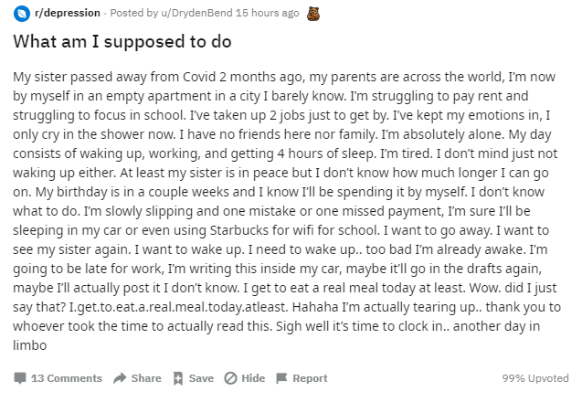
Data Collection
The data used to build the text classifier were extracted from the Reddit API. Specifically, data were scrapped posts in 2 subreddits, namely:
1. r/depression and
2. r/bipolar
The ‘selftext’ is used to build the text classification model.
title
selftext

Slide 5

Data Cleaning
Data were cleaned to:
Remove duplicates
Remove posts without text (e.g. posts with only image or video)
After cleaning, the dataset contains:
Subreddit | Number of posts
Depression | 976
Bipolar | 856

Slide 6
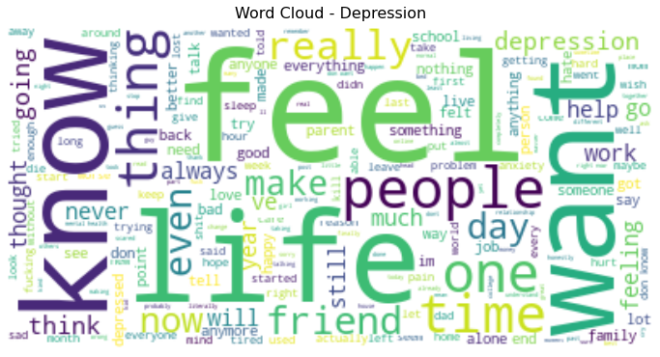
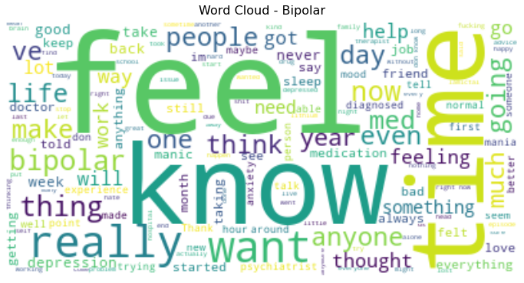
Initial EDA: Word Cloud
Observations:
Similar words – expected as there are some similarities to the conditions

Slide 7
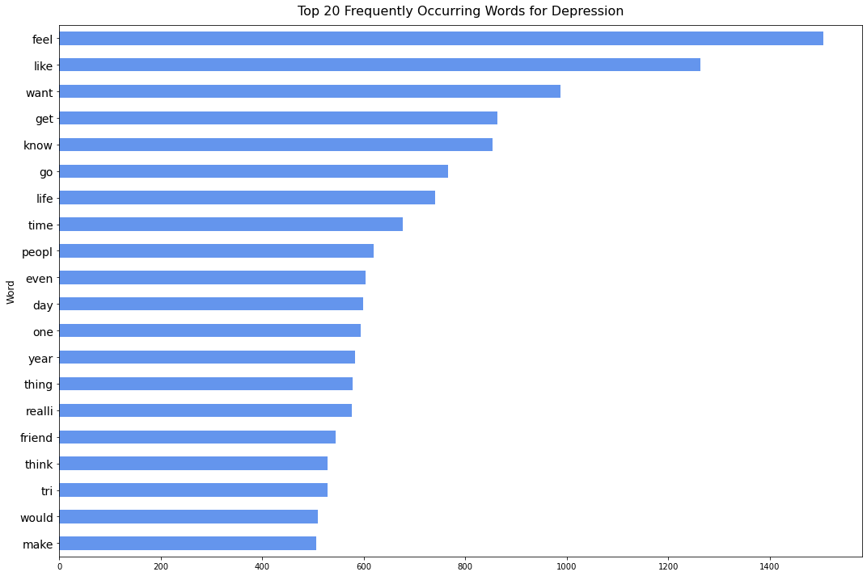
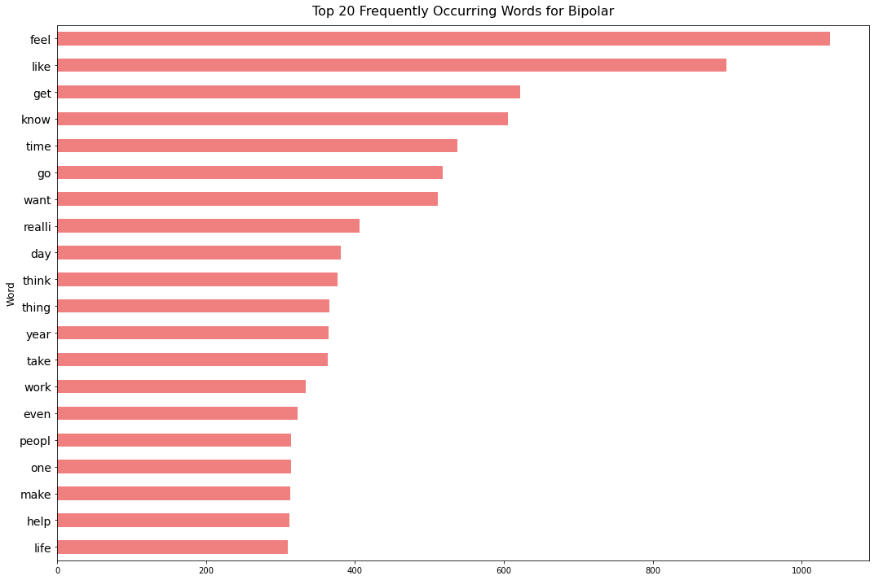
Preprocessing/ EDA: Frequently Occurring Words
Preprocessing:
Use regular expressions to remove non-word characters
Convert words to lower case
Use NLTK to remove stop words
Remove words related to the subreddits such as 'depression' and 'bipolar' to prevent target leakage
Further preprocessing:
Remove similar words frequently occurring in both subreddits to improve model accuracy

Slide 8
Modelling & Model Evaluation
Baseline Accuracy
Depression (Class 1) : 0.5328
Bipolar (Class 0) : 0.4672
Model | Accuracy | Sensitivity | Specificity | Precision | F1 Score
Logistic Regression with CountVectorizer | 0.7860 | 0.8279 | 0.7383 | 0.7829 | 0.8048
Logistic Regression with TfidfVectorizer | 0.8122 | 0.8197 | 0.8037 | 0.8264 | 0.8230
MultinomialNB with CountVectorizer | 0.8057 | 0.8238 | 0.7850 | 0.8138 | 0.8187
Multinomial NB with TfidfVectorizer | 0.8144 | 0.8525 | 0.7710 | 0.8093 | 0.8303
Support Vector Machine with CountVectorizer | 0.7729 | 0.8361 | 0.7009 | 0.7612 | 0.7969
Support Vector Machine with TfidfVectorizer | 0.8188 | 0.8852 | 0.7430 | 0.7970 | 0.8388
*Pipeline & GridSearch were applied for hyperparameter tuning

Slide 9
Modelling & Model Evaluation
Model | Accuracy | Sensitivity | Specificity | Precision | F1 Score
Logistic Regression with TfidfVectorizer | 0.8122 | 0.8197 | 0.8037 | 0.8264 | 0.8230
Multinomial NB with TfidfVectorizer | 0.8144 | 0.8525 | 0.7710 | 0.8093 | 0.8303
Support Vector Machine with TfidfVectorizer | 0.8188 | 0.8852 | 0.7430 | 0.7970 | 0.8388
Support Vector Machine with TfidfVectorizer & Multinomial NB with TfidfVectorizer
High accuracy and F1 score
High sensitivity, i.e. perform well predicting positive class (depression)
Low specificity, i.e. perform poorer in predicting negative class (bipolar)

Slide 10
Modelling & Model Evaluation
Model | Accuracy | Sensitivity | Specificity | Precision | F1 Score
Logistic Regression with TfidfVectorizer | 0.8122 | 0.8197 | 0.8037 | 0.8264 | 0.8230
Multinomial NB with TfidfVectorizer | 0.8144 | 0.8525 | 0.7710 | 0.8093 | 0.8303
Support Vector Machine with TfidfVectorizer | 0.8188 | 0.8852 | 0.7430 | 0.7970 | 0.8388
Logistic Regression with TfidfVectorizer
Comparable accuracy and F1 score
Balanced sensitivity and specificity

Slide 11

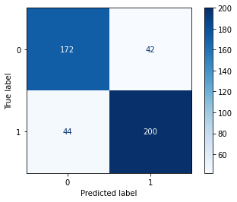
Review of Selected Model:
Logistic Regression with TfidfVectorizer
False Positives (bipolar cases misclassified as depression)
Short & generic text
‘Except instead of powers I lose my mind…’
Text that relate more to depression (i.e. may not be actual misclassification)
‘I’m feeling really depressed rn but I can’t tell anyone...‘
Text that talk about both bipolar and feeling depressed
‘I am living in a third world country and unfortunately I have bipolar. Even though most of the time I am depressed I can act like I am "normal" around people.
False Positive
False Negative
False Negative (depression cases misclassified as bipolar)
Short & generic text
‘I didn't wanted to talk with my brother because he and me like superheroes.’
Text that talk about both depression and bipolar
‘I received a new diagnosis from my second psychiatrist. It turned out I was on the bipolar spectrum, but I was so barely on it that no one noticed. My depressive symptoms were so aggressive, and my hypomania (if you could even call it that) just looked like I was very productive…’

Slide 12
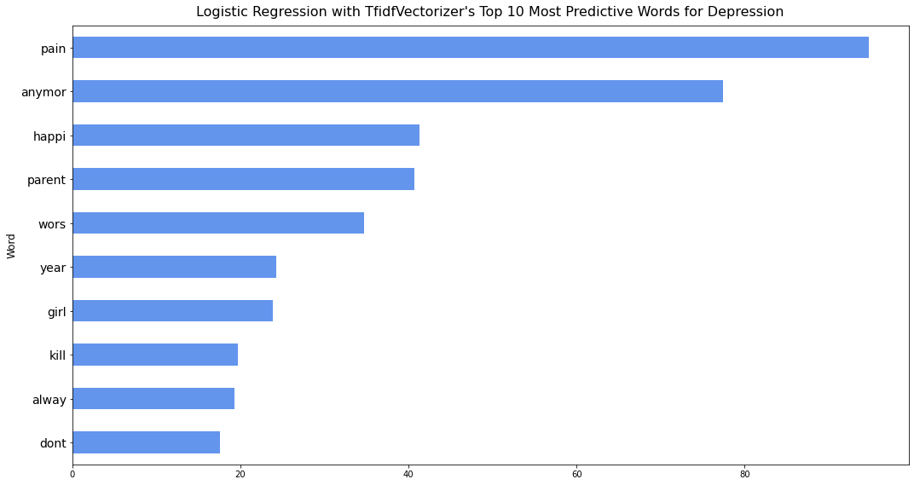
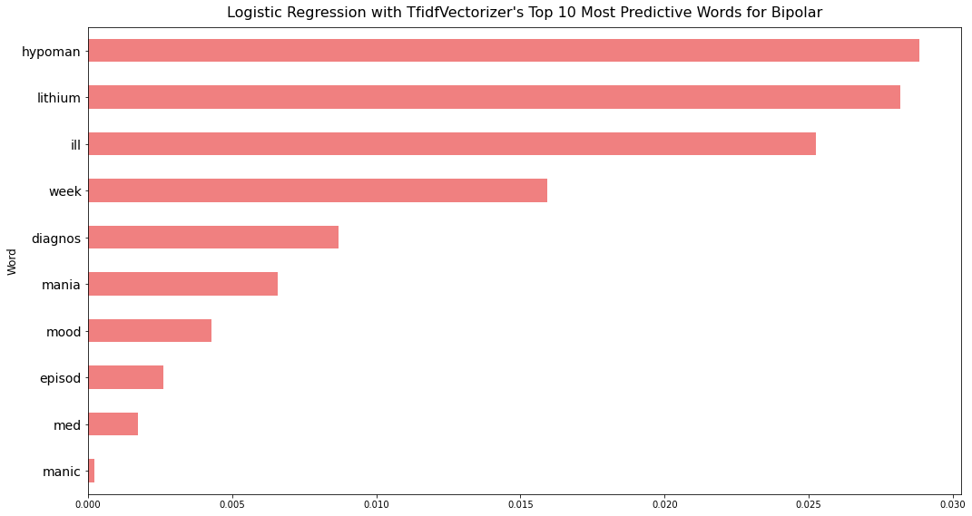
Review of Selected Model:
Logistic Regression with TfidfVectorizer

Slide 13
Conclusion & Recommendations
While Support Vector Machine and Multinomial NB with TfidfVectorizer are best in terms of accuracy, they perform relatively poorly in specificity.
Logistic Regression model with TfidfVectorizer is recommended as it has comparable accuracy with the SVM and Multinomial NB models, but more balanced in sensitivity and specificity, so as to ensure good patient experience for both depression and bipolar patients.

